Slide 1

Rockbuster Stealth Data Analysis Project
Jocelyn Garcia, 2023

Slide 2
Its to use its existing movie licenses to launch an online video rental service to stay competitive. Key Questions: What was the average rental duration for all videos? Which movies contributed the most/least to revenue gain? Which countries are Rockbuster customers based in? Where are customers with a high lifetime value based? Do sales figures vary between geographic regions?
Objective

Slide 3
Contains information about Rockbuster’s film inventory, customers, and payments, among other things
Data Set
Number of films: 1000
Number of customers:599
Countries: 109
Rental rate avg: $2.98
Rental rate max: $4.99
Rental rate min: $0.99
Average rental duration: 4.9 days
Release year for all films: 2006
Average replacement cost: $19.98

Slide 4
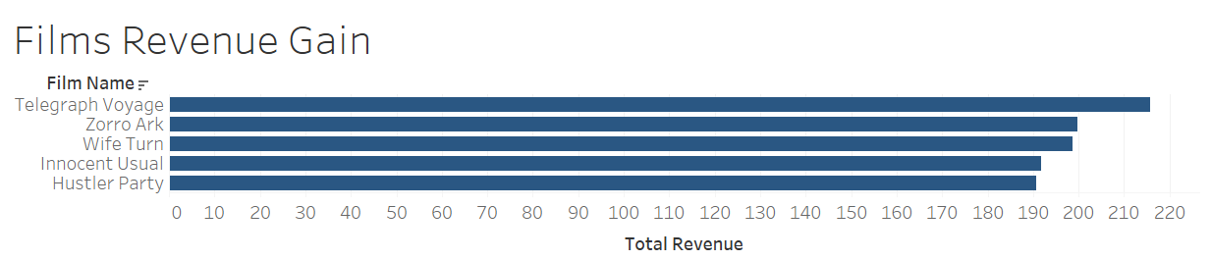

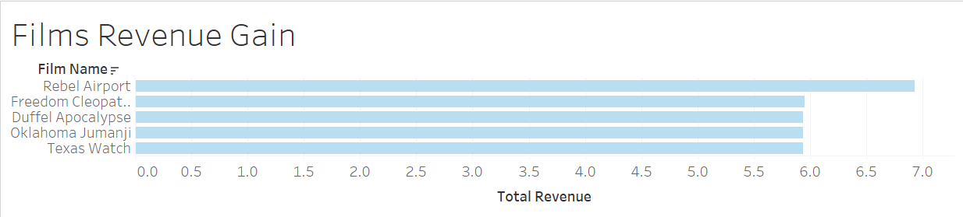

Analysis Data shows which movies contributed with the highest and lowest revenue gain. Film, “Telegraph Voyage”, highest revenue, with 215.750 Film, “Texas Watch”, lowest revenue, with 5.94

Slide 5
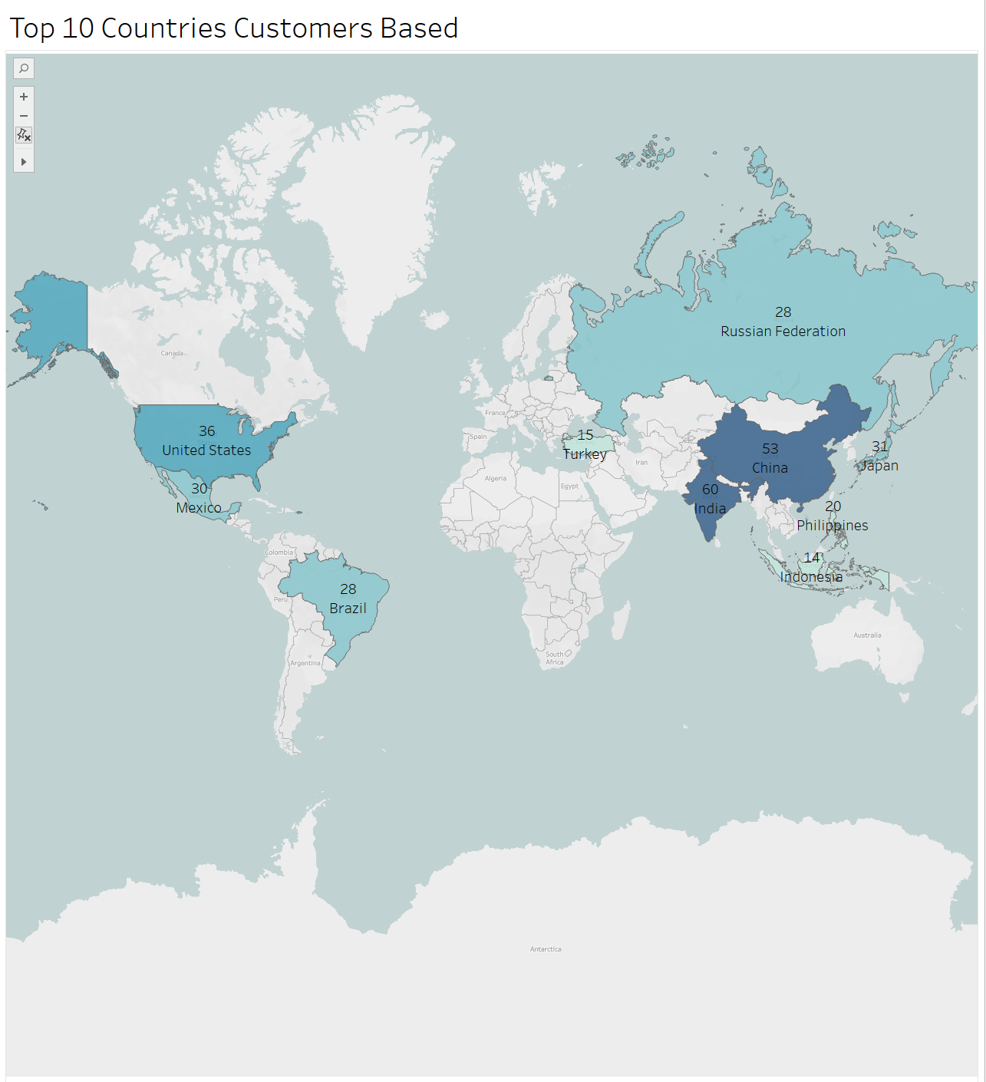

Analysis Data shows the top 10 countries and the number of Rockbuster customers. The top 3 countries are India, China, and United States.

Slide 6
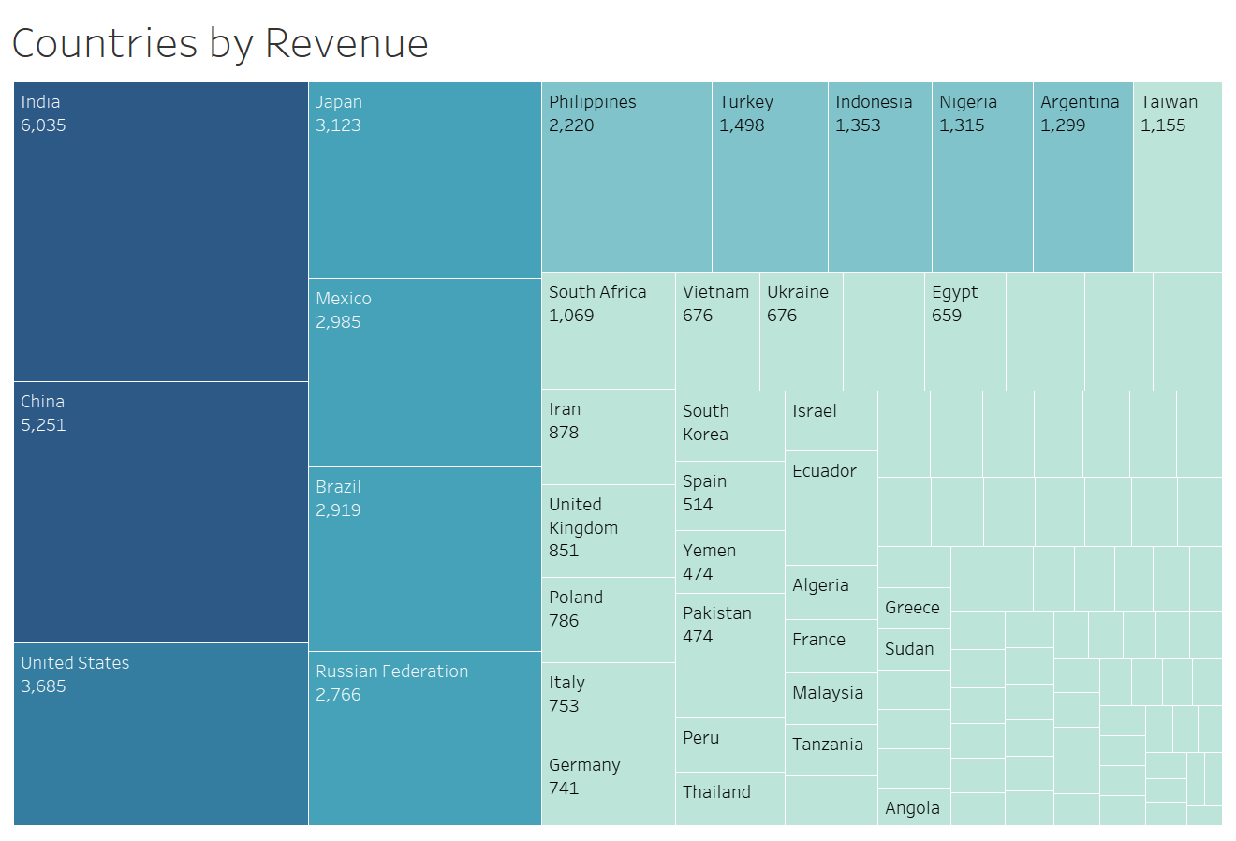

Analysis Sales figures between geographic regions Data shows that India, China and United States has the highest spending (in 2006); while the bottom two are American Samoa and Lithuania.

Slide 7
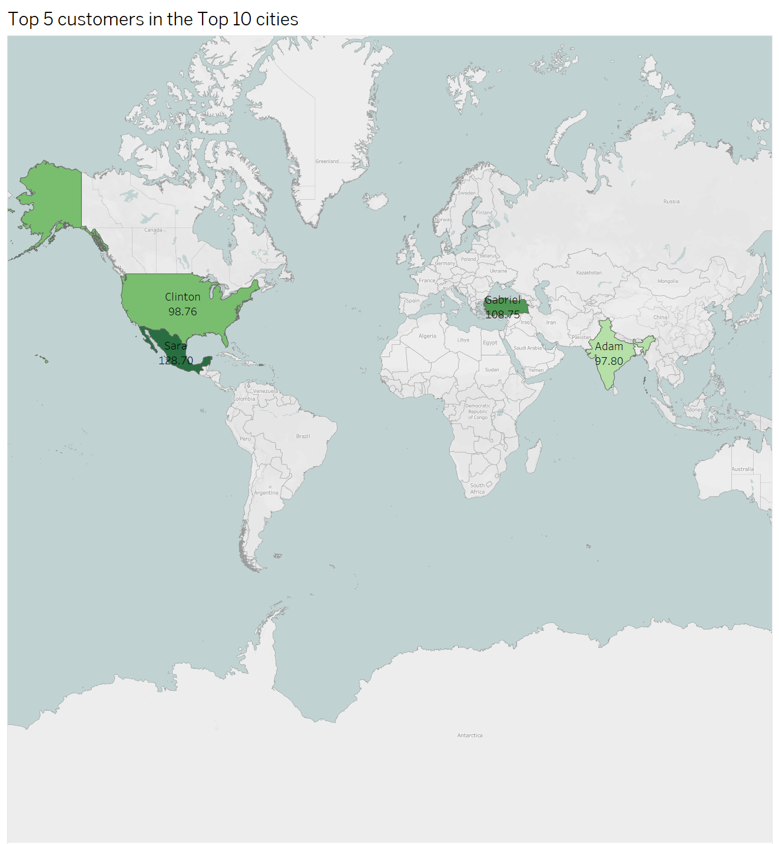
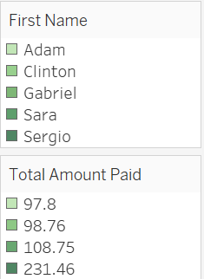
Analysis Data shows the top 5 customers in the top 10 cities who have paid on Rockbuster movie rentals. Customers are based in Mexico, Turkey, United States, and India.

Slide 8
The top five films are Telegraph Voyage, Zorro Ark, Wife Turn, Innocent Usual, and Hustler Party. These films brought in a total of $165 or more in total revenue. In contrast, the bottom three films, Texas Watch, Oklahoma Jumanji, and Duffel Apocalypse, only earned around $6 in total revenue. The top three countries with the most customers are India, China, and the United States. This means that these countries have the highest sales figures. The top loyal customers are located in India, the United States, and Mexico.
Conclusions

Slide 9
Consider offering promotional deals or special discounts for customers who rent these films. Offer related titles to attract customers who are interested in those types of films. Monitor the least popular movies and consider phasing them out and replacing them with more popular films. Provide localized content and language options for customers in these countries, such as subtitles or films in their local language. Keep up to date with the latest trends and popular films in these countries to offer those films and attract more customers. Promote existing movies suitable for different regions. Test the pilot online video rental service with these loyal customers within these countries.
Recommendations

Slide 10
For additional questions, feel free to contact on Jocelyn.Garcia@rockbuster.com Link to visualization: https://public.tableau.com/app/profile/jocelyn.garcia
Resources and Contact Information

